Slide 1
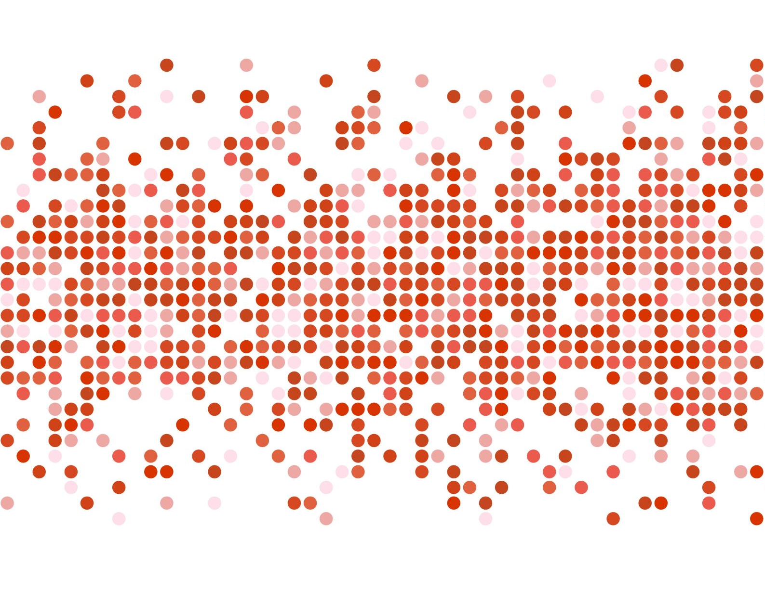
Customer Churn Analysis
Neethu Sunitha Pradeepan

Slide 2
Business Understanding
The dataset is about the telecommunication industry
EDA is used to analyze the customers who are likely to churn from this telecommunication company
EDA is used to get meaning insights from the data given and proving recommendations on how to improve the service and can also take necessary actions to retain their customers

Slide 3

Understanding the data

Slide 4

Target Variable
Data is highly imbalanced with a ratio of 74:26
Customer churn is the target variable considered in this analysis
We need to analyze the data with other features while taking target values separately to get some insights
In depth univariate and bivariate analysis has been performed to get meaningful insights

Slide 5
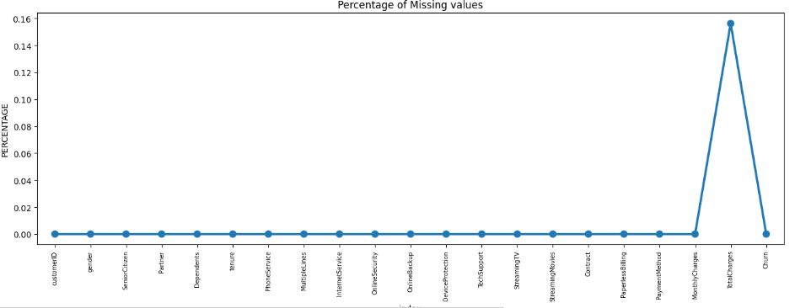
Missing data
Since the % of these records compared to total dataset is very low ie 0.15%, it is safe to ignore them from further processing.

Slide 6

Univariate Analysis

Slide 7
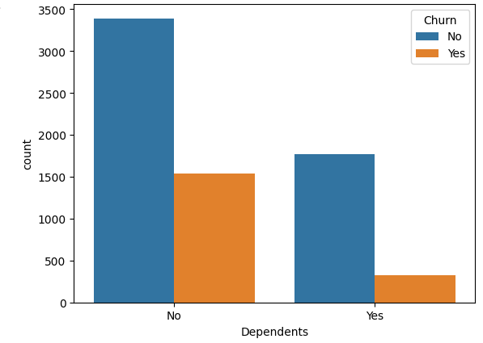
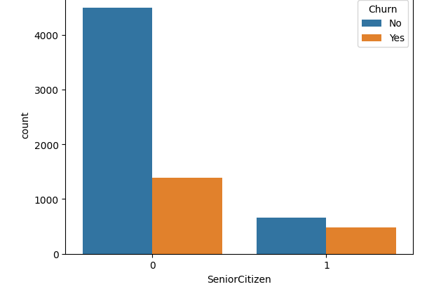
Insights
Senior citizens are more likely to churn~42%
Cxs who are having no dependents are more likely to churn with a churn percentage of 31.27 compared to cxs with dependants

Slide 8
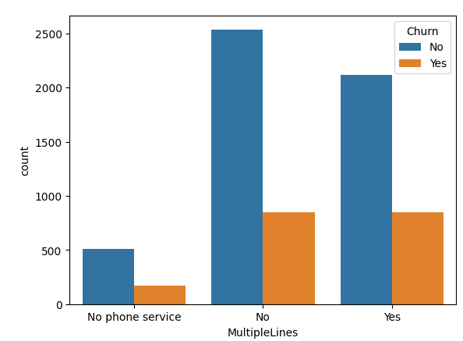
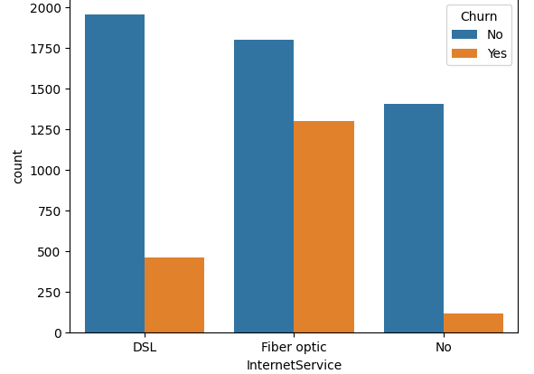
Cx with fiber optics connection more likely to churn with a churn percentage of 41.89
CX with multiple lines have slight chance to churn~29%

Slide 9
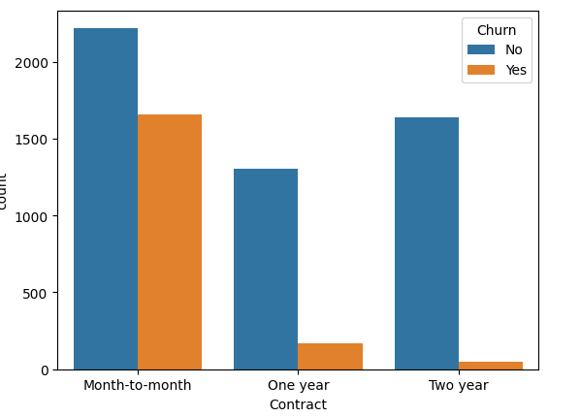
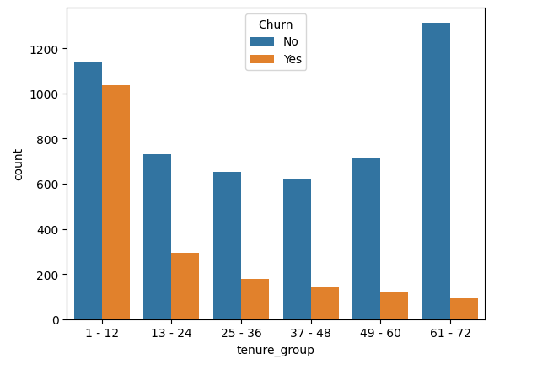
Monthly contract cxs are also having high chance to churn ~ 42.70% (No commitments)
cxs within the tenure of 1-12 has the highest churn rate

Slide 10
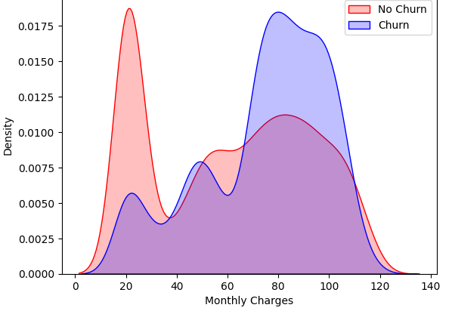
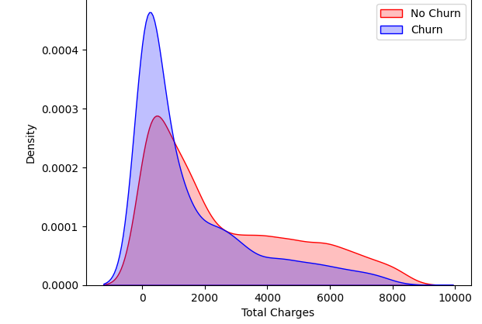
As higher Churn at lower Total Charges
if we combine the insights of 3 parameters i.e. Tenure, Monthly Charges & Total Charges then the picture is bit clear :- Higher Monthly Charge at lower tenure results into lower Total Charge. Hence, all these 3 factors viz Higher Monthly Charge, Lower tenure and Lower Total Charge are linkd to High Churn.

Slide 11
Bivariate Analysis

Slide 12
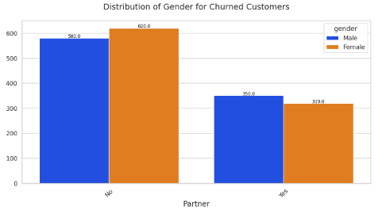
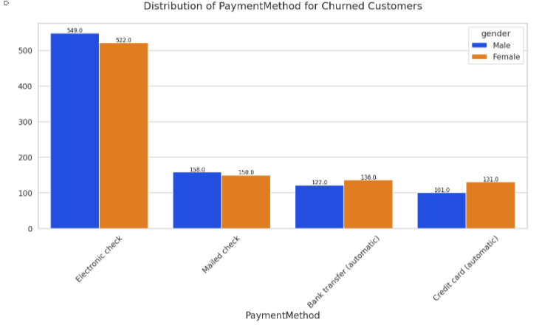
Bivariate Analysis

Slide 13

CONCLUSION

Slide 14
Univariate Analysis
Senior citizens are more likely to churn~42%
Monthly contract cxs are also having high chance to churn ~ 42.70% (No commitments)
Cxs within the tenure of 1-12 has the highest churn rate
Male cxs who do electronic check payment method are also likely to churn with 45.28% than their counterparts
Cxs who prefer paperless billing are also likely to churn~34
Cxs who are having no partners are more likely to churn with a churn percentage of 32.97% compared to cxs with partners(19.71%)
Cxs who are having no dependents are more likely to churn with a churn percentage of 31.27 compared to cxs with dependents
CX with multiple lines have slight chance to churn~29%
Cx with fiber optics connection more likely to churn with a churn percentage of 41.89
cx not having any online security/tech support are more likely to churn with 42%
cx with no online backup and no device protection are more likely to churn with 39%
cxs who are not using any streaming are also likely to churn with ~34%

Slide 15
Bivariate Analysis
Females cxs who don't have partners are more likely to churn than their counterparts
Female cxs who pay via credit card are more likely to churn
Male cxs who do electronic check payment method are also likely to churn than their counterparts
Female cxs within the tenure of 1-12 has the highest churn rate than male
Male cxs without any phone service are more likely to churn
Female cx without multiple lines are more likely to churn than males
Male cxs with online security are less likely to churn than females
Male cxs with tech support are less likely to churn than females with tech support
Female cxs having monthly contract are more likely to churn
Female cxs without paperless billing are more like to churn than males

